Slide 1

Immersive Technology Development
Lesson 2:
Setting up GitHub Desktop
Elyas Chua-Aziz
cel9@np.edu.sg
Diploma in IM
October 2021

Slide 2
Lesson Objectives
Set up GitHub Desktop.
Clone a repository using GitHub Desktop.
Create a new repository using an existing Unity project.

Slide 3
Using GitHub Desktop
This semester, we will use GitHub Desktop to collaborate.
It is more reliable, but requires us to perform Git actions (e.g. commit, push, pull, etc.) outside of Unity.

Slide 4
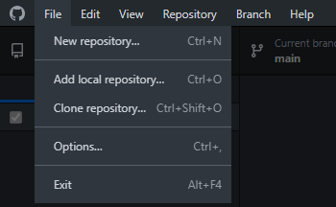
Cloning a Repository
Open GitHub Desktop.
Log in to your GitHub account if you haven’t.
Click on ‘File’ on the toolbar.
‘New repository’ will create a new folder on your laptop, make it a git repository, and start tracking the repository.
‘Add local repository’ lets you start tracking an existing repository on your laptop.
‘Clone repository’ lets you clone a project from GitHub.
We will focus on this first

Slide 5
Cloning a Repository
Click on ‘Clone repository’

Slide 6
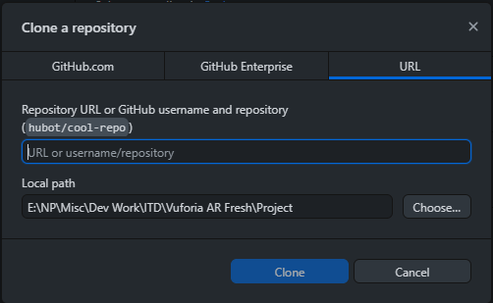
Cloning a Repository
This window will pop up. Click on the ‘URL’ tab.
Enter the URL to your git repository here.

Slide 7
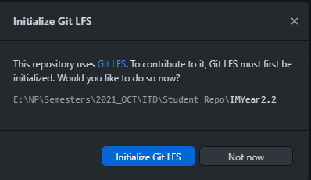
Cloning a Repository
Next, choose a path on your laptop to save the repository to.
Click ‘Clone’ once you are ready.
The software will now copy the files on the repository onto your laptop.
This window should pop up once the cloning is done. Click ‘Not now’.

Slide 8
Cloning a Repository
With that done, we have successfully cloned our first repository.
Any slides, demo projects, and other learning materials will be added to this repository.
This applies to your DDA module as well.
However, cloning a repo does not mean you can modify the repository.
You will be able to change the local files you have on your laptop, and you will be able to commit them.
But you won’t be able to push those changes to GitHub.

Slide 9
Demo Time!

Slide 10
Your turn!
Using GitHub Desktop, clone a repository from this URL:
https://github.com/watchyourhead/IMYear2.2.git
Navigate through the folders and look for the excel spreadsheet named “Math is Fun”
Solve the equation beside your name and type your answer into the chat!

Slide 11

Creating a Repo
Now that we’ve seen how to clone a repo, let’s try creating one.
Let’s use an existing Unity project and make it a repo so that others can work on it with us.
First, go to the repo that you cloned earlier.
Go to Modules > ITD > Week 1 > Git Repo Files
Copy both files.

Slide 12
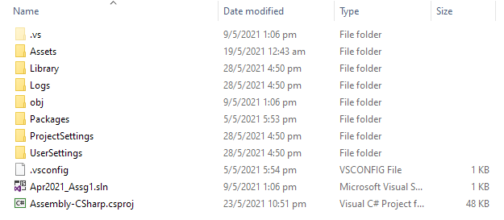
Creating a Repo
Open the folder that contains the existing Unity project.
You should see the ‘Assets’, ‘Library’, and other Unity default folders.
Paste both files you copied into this folder.

Slide 13
Creating a Repo
Open GitHub Desktop.
Click on ‘File’ on the toolbar.
This time, select ‘Add local repository’
Navigate to the folder that contains the ‘Assets’ folders, then click ‘Select’

Slide 14
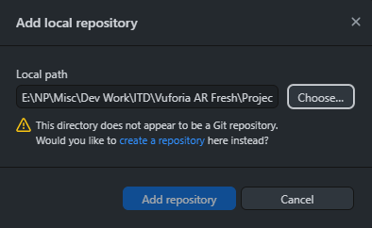
Creating a Repo
This window will pop up. Click on ‘create a repository’ highlighted in blue.

Slide 15
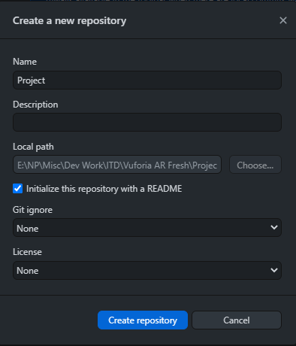
Creating a Repo
This window will pop up.
Use the default name provided.
You can add your own Description.
Make sure the README option is checked.
Keep the last two options as ‘None’
Click ‘Create repository’

Slide 16
Creating a Repo
This window makes another appearance.
Click ‘Initialize Git LFS’ this time.

Slide 17
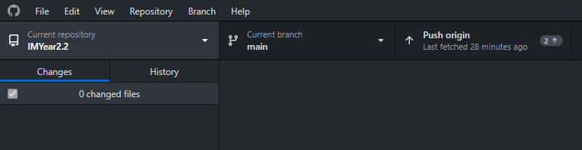
Creating a Repo
Once the repo is created, click the ‘Current repository’ button and select your newly created repo.
After selecting the new repo, click on the ‘History’ tab.

Slide 18
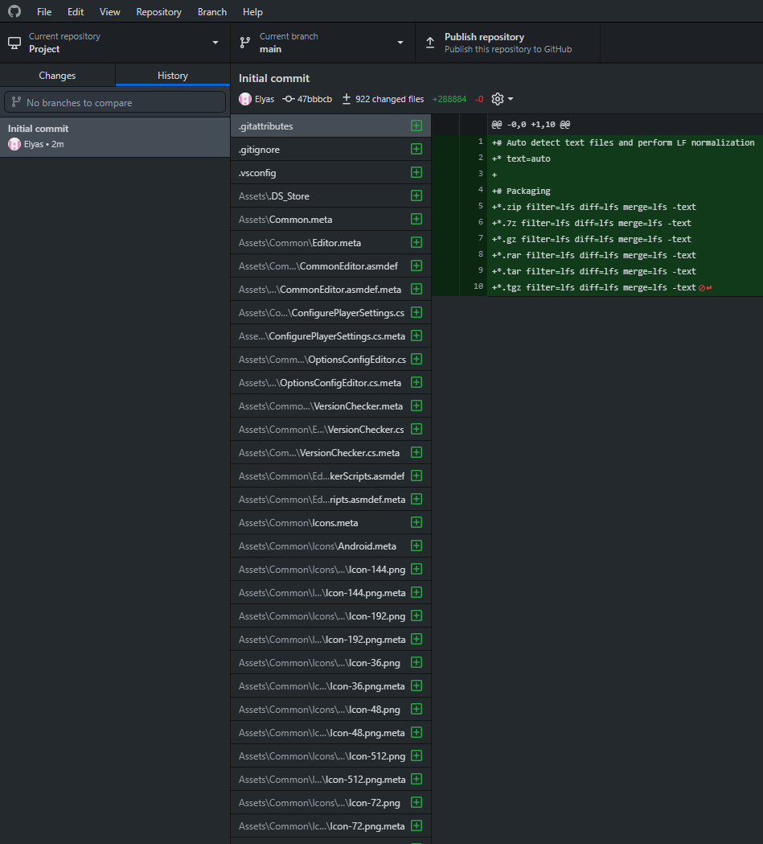
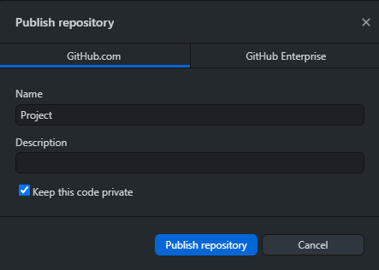
Creating a Repo
You will see that all the files in your project folder have been committed under an initial commit.
This is done automatically by GitHub Desktop.
Now, click the ‘Publish repository’ button at the top.
This window will pop up.
Once again, click the ‘Publish repository’ button.

Slide 19
Creating a Repo
After a few minutes, the push should have succeeded.
Head to GitHub on your browser and check that the repo has been created.
You can now head to the settings page of your repo and start adding collaborators.

Slide 20
Demo Time!

Slide 21
Your turn!
Start grouping yourselves into pairs for Assignment 1.
Enter your pairings here: https://docs.google.com/spreadsheets/d/1xMP8fV7VwGmXIe1cA_tr5VknOk7lS-olYAXtlv2aSXc/edit?usp=sharing
Create a new Unity project to use for your Assignment 1.
Use GitHub Desktop to create a repository in that project.
Add your groupmate as a collaborator and input the URL to your project in the same spreadsheet above.

